Slide 1


CHANDRASEKHAR JONNALAGADDA
Feb 8th, 2024

Slide 2

Outline
• Executive Summary
• Introduction
• Methodology
• Results
• Conclusion
• Appendix
2

Slide 3
Executive Summary
• Summary of methodologies
• API Calls
• Web-Scraping
• Data Wrangling
• Exploratory Data Analysis with Data Visualization
• Exploratory Data Analysis with SQL
• Interactive Map Construction via Folium
• Interactive Dashboard Construction via Plotly
• Machine Learning Algorithm Training
• Summary of all results
• Data Visualization/SQL Outcomes
• Map and Dashboard Outcomes
• Machine Learning Outcomes
3

Slide 4
Introduction
• SpaceX is making strides in the spacecraft industry via its reusable rocket stages. Most of the time, its first rocket stage is recoverable and reusable, drastically reducing price and time for future launches. You, SpaceY, the new rival company, are interested in predicting the outcomes of SpaceX missions and landings and adopting some of the successful variable combinations for yourselves
• Using data science tools, SpaceY will be able to determine:
• Is SpaceX's first rocket stage recoverable? Will it land properly and be reusable, saving SpaceX money?
• What rocket parameters influence whether a launch or landing is successful?
4

Slide 5

Section 1
5

Slide 6
Methodology
Executive Summary
• Data collection methodology:
• API Calls and Web-scraping were used to pull data from SpaceX, IBM, and Wikipedia
• Perform data wrangling
• Exploring the data types allowed me to change the launch outcomes into a new 'Class' category, utilizing one-hot encoding to allow for later data manipulation
• Perform exploratory data analysis (EDA) using visualization and SQL
• Perform interactive visual analytics using Folium and Plotly Dash
• Perform predictive analysis using classification models
• Using GridSearchCV, fit_transform(), and fit() on various Machine Learning models, parameters which maximized the R^2 value were determined. Confusion matrices
6
were also created

Slide 7
Data Collection
• API calls were made via requests to datasets of SpaceX and IBM. Responses were
uploaded into data frames. Info included were rocket booster versions, cores, payloads, and launchpad details
• An API call to obtain launch data resulted in a json file which was then
normalized and converted into a more easily readable Pandas data frame.
• All of the data obtained via API calls were consolidated into a single data frame (with missing values of 'Payload Mass' filled with the average payload mass.
• Additional launch data was web-scraped from Wikipedia by utilizing the HTTP get function and BeautifulSoup. Data were converted into a Pandas data frame
7

Slide 8
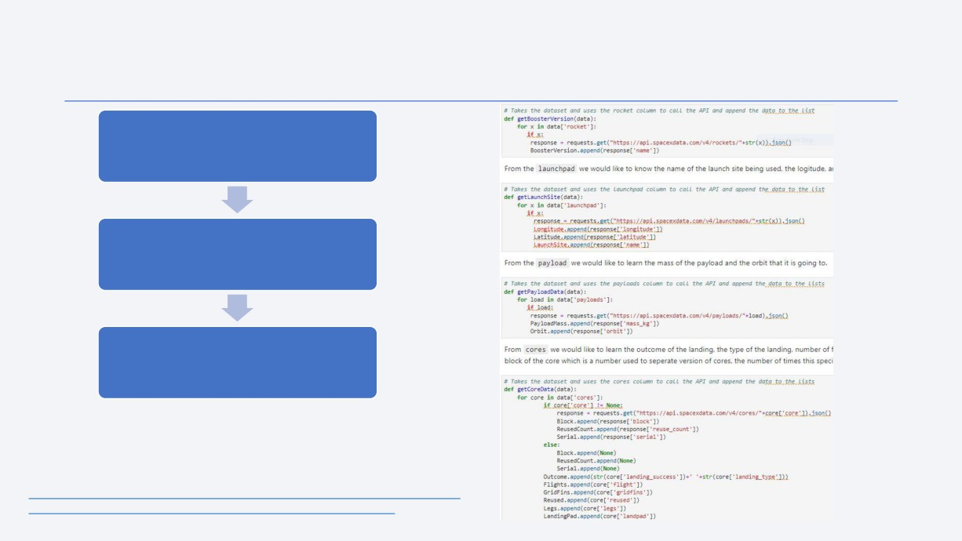
Data Collection - SpaceX API
requests.get() was used to obtain
data from the API
The response was appended into empty data frames
For each category of interest, a
function was defined that would obtain its data then append it into a data frame
• The GitHub URL of the completed SpaceX API calls notebook is here for your convenience:
https://github.com/SriChandra2520/IBM-Applied-Data-Science-Capstone-Final-Presentation/blob/main/data-collection-api.ipynb
8

Slide 9
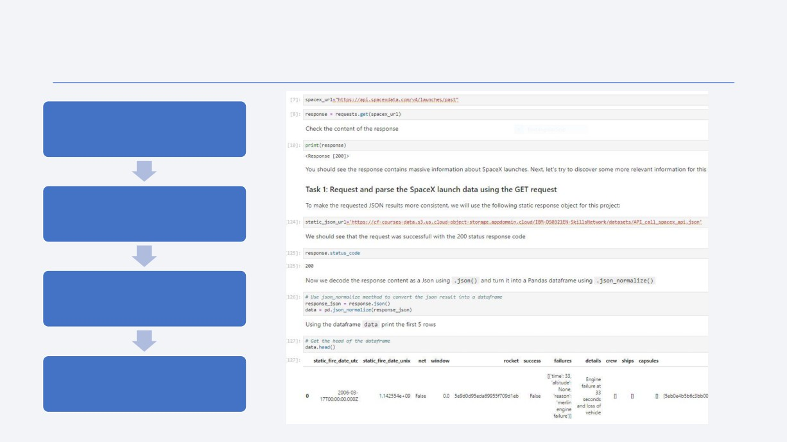
Data Collection - SpaceX API (json file)
requests.get() was again used to
obtain data from the API
This time, the response was
converted into a Pandas data frame using the .json_normalize() function
The first 5 entries in the data frame could be analyzed using the .head() function
Data was eventually added to the prior API calls. All data were
consolidated into one data frame
9

Slide 10
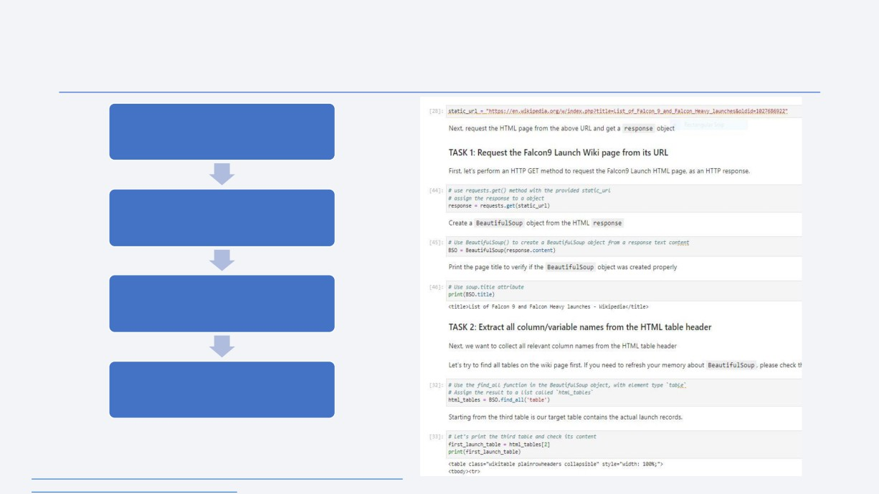
Data Collection - Scraping
requests.get() was used in conjunction
with BeautifulSoup to extract information from
the SpaceX Falcon 9 Launch details on Wikipedia
The response was then parsed through by
searching for all present 'th', signifying headers
The headers and their data were later extracted using a collection of given functions and stored
in a dictionary
The dictionary was converted into a Pandas data frame
• The GitHub URL of the completed web scraping notebook is here for your
convenience:
10
https://github.com/SriChandra2520/IBM-Applied-Data-Science-Capstone-Final-Presentation/blob/main/Data_Collection_Data-webscraping.ipynb

Slide 11
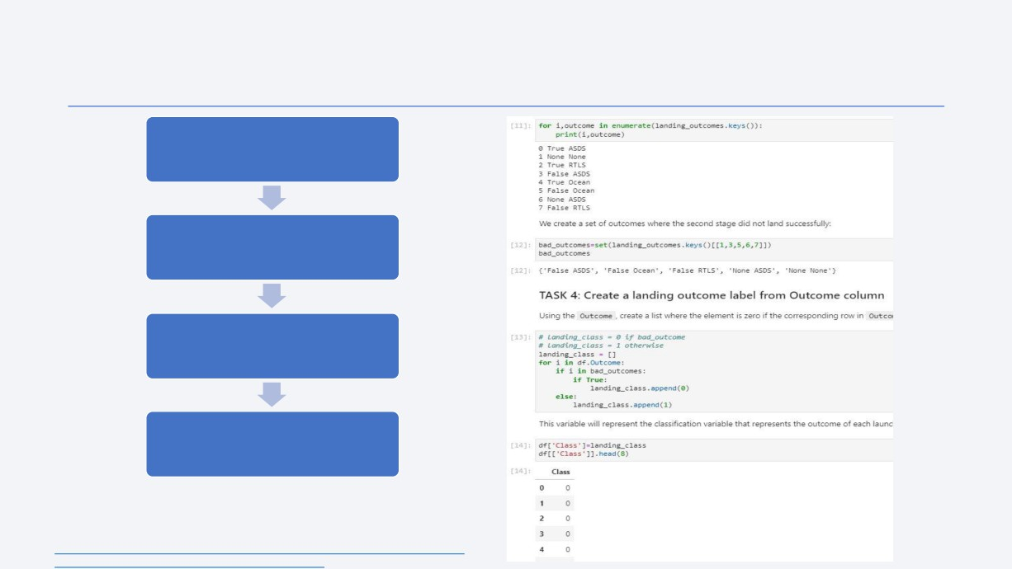
Data Wrangling (One-Hot Encoding)
Using .value_counts() and a subsequent .keys()
on the 'Outcomes' category, the different types
of landing outcomes were determined
The landing outcomes were separated into
two different groups (successful and failed)
Using one-hot encoding, the landing outcomes
were assigned either a '1' (successful landing)
or '0' (failed landing) for a new column 'Class'
The data frame was then appended with the
new 'Class' column
• The GitHub URL of the completed data wrangling related notebooks is
here for your convenience:
11
https://github.com/SriChandra2520/IBM-Applied-Data-Science-Capstone-Final-Presentation/blob/main/Data_Collection_Data-Data%20wrangling.ipynb

Slide 12
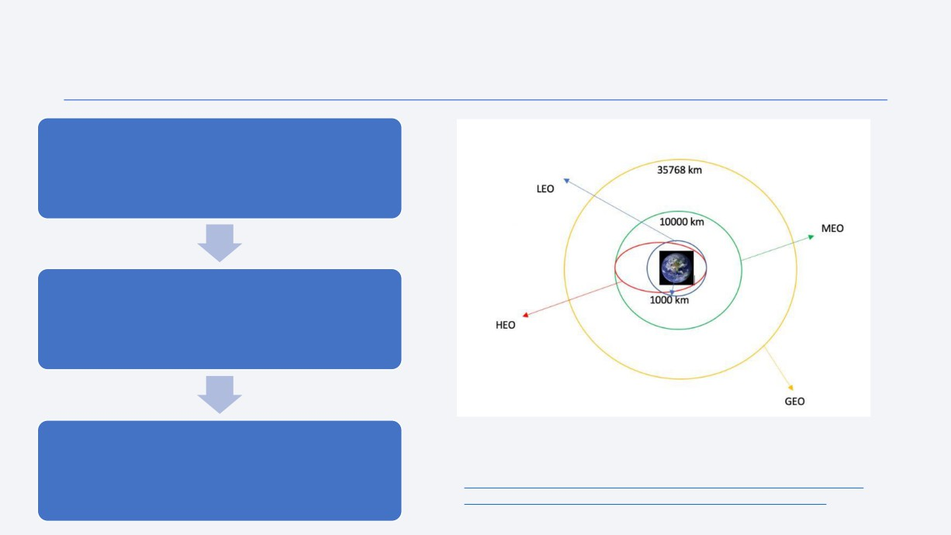
EDA with Data Visualization (Orbit Success Rate)
A bar chart was used to conveniently visualize
success rates of landings from different orbits. Orbit is a key factor in determining landing success or failure
A line graph was used to conveniently
visualize success rates of landings by year.
Determining trends year-to-year may be influential in determining chance of future success
• The GitHub URL of the completed EDA with data visualization
Additional scatter plots were made comparing categories such as orbit, flight
notebook is here for your convenience:
12
number, launch site, and payload mass
https://github.com/SriChandra2520/IBM-Applied-Data-Science-Capstone-Final-Presentation/blob/main/EDA%20with%20visualization%20results%20slides.ipynb

Slide 13

EDA with SQL
• By loading and utilizing SQL through a Jupyter notebook, multiple queries involving payload mass, booster versions, dates, and landing success were performed
• Some of the queries included:
• Average payload mass carried by the Falcon 9 v1.1
• First successful ground pad landing date
• Total number of successful missions versus failed missions
• Boosters that carried the maximum payload mass
• Boosters that carried payloads within a range of 4000kg and 6000kg
• The GitHub URL of the completed EDA with SQL notebook is here for your
convenience:
https://github.com/SriChandra2520/IBM-Applied-Data-Science-Capstone-Final-Presentation/blob/main/EDA%20with%20SQL%20results%20slides.ipynb
13

Slide 14

Build an Interactive Map with Folium
• Using a Folium map:
• Circular markers were used to identify four specific SpaceX launch sites that launch F9 rockets
• Colored markers were used to denote launch success (green) or failure (red)
• Marker clusters were used to neatly condense the many markers into the vicinity of each site
• Additional markers were placed on landmarks of interest (highways, railways, coastlines, and cities) and lines were used to measure the distance between launch sites and said landmarks
• Visualizing the successes and failures of each launch site via a Folium map is helpful
for making more informed predictions about launches from specific sites
• The GitHub URL of the completed interactive map with Folium map is here for your convenience:
https://github.com/SriChandra2520/IBM-Applied-Data-Science-Capstone-Final-Presentation/blob/main/interactive_map_with_Folium_results_slides.ipynb
14

Slide 15

Build a Dashboard with Plotly Dash
• Using Plotly a dashboard was created that allows the user to toggle different launch sites and payload weights to determine their effects on launch success
• A dropdown selection bar was included to allow for selection of a specific launch site or the 'All Sites' option
• A slider was included in order to adjust the payload weight that the plots would include data for, displaying the difference in success for various weight ranges
• A pie chart was included to display different launch site success rates (or percentage of total success per site for the 'All Sites' selection)
• A scatter plot was added to help visualize successes of different booster versions across different payload weights, further helping to elucidate possible barriers to a successful launch amongst a previously unexplored variable relationship
• The GitHub URL of the completed Plotly Dash lab is here for your convenience :
https://github.com/SriChandra2520/IBM-Applied-Data-Science-Capstone-Final-Presentation/blob/main/SpaceX_Dashboard_App.py
15

Slide 16
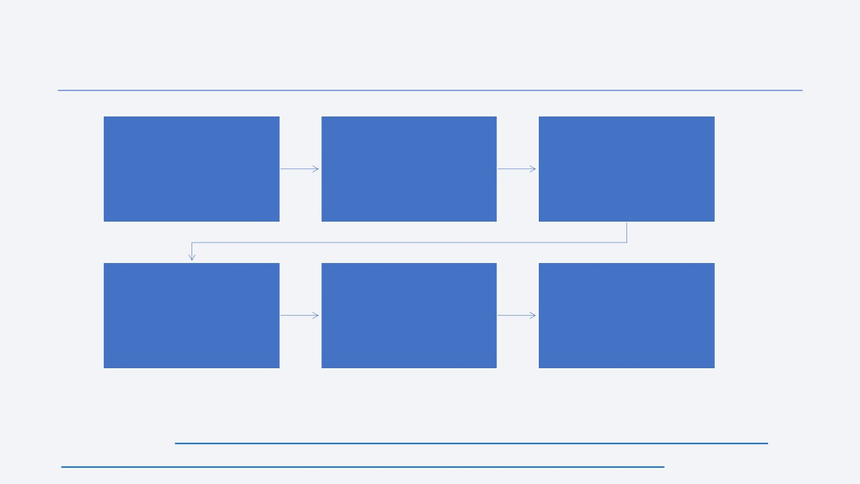
Predictive Analysis (Classification)
Data was loaded regarding launch
success and loaded into
GridSearchCV helped in determining
a numpy array and stored as Y. The
X and Y were split into training and
the best parameters and best possible R^2 accuracy score for the landing data amongst four different
entire data frame was standardized into the z-score using the
testing data using the
.train_test_split() function
.StandardScaler() function and saved as X
machine learning methods.
The most accurate model was
A confusion matrix was plotted for
selected from the options of logistic regression, support vector
each method, displaying the strengths and weaknesses of the
A bar chart was made to display
the maximum potential accuracy of each method
machine, decision tree, and K nearest neighbor
specific method
• The GitHub URL of the completed predictive analysis lab is here for your convenience:
https://github.com/SriChandra2520/IBM-Applied-Data-Science-Capstone-Final-Presentation/blob/main/SpaceX_Dashboard_App.py

Slide 17
Results
• Exploratory data analysis results and screenshots
• Interactive analytics demo in screenshots
• Predictive analysis results and screenshots
17

Slide 18

Section 2

Slide 19
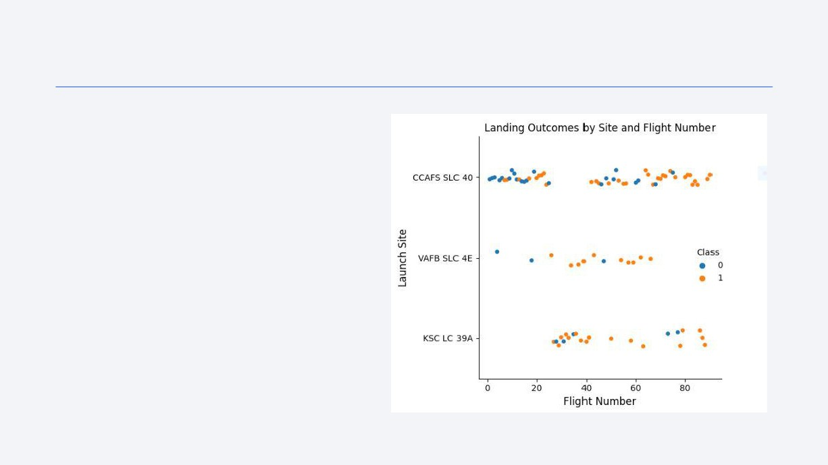
Flight Number vs. Launch Site
• Given that the flight numbers are
ordered by date (lower number = earlier date), the success rate has improved over time
• Most of the unsuccessful
landings occur at CCAFS SLC 40
• Most of the successful landings occur at KSC LC 39A or VAFB SLC 4E
19

Slide 20
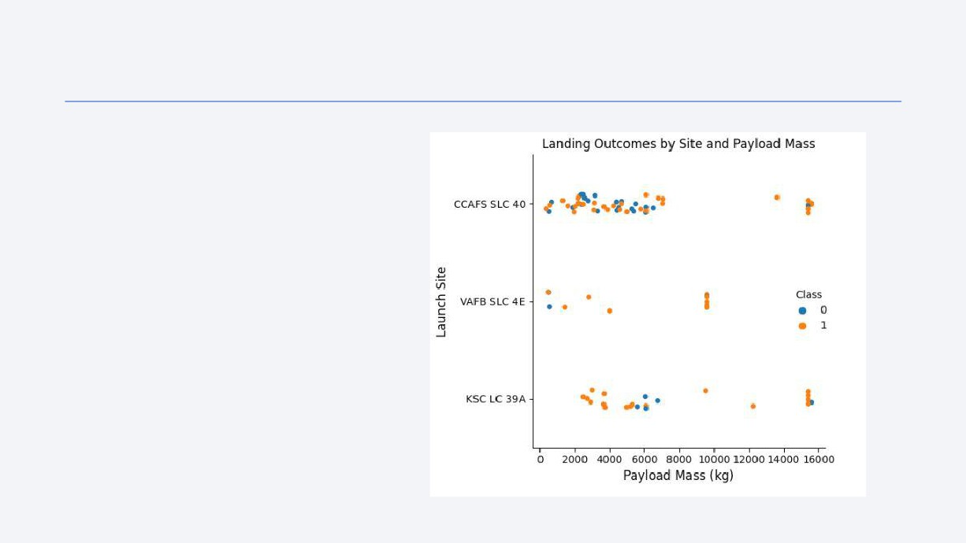
Payload Mass vs. Launch Site
• Heavier payload masses (8000kg+) tend to be successful landings, but more rockets carried lighter payloads, meaning less data available for those heavier payloads
• KSC LC 39A is the most successful in the lower payload mass range (0- 5000kg)
• Payload masses between
8000kg and 14000kg have all been successful
20

Slide 21
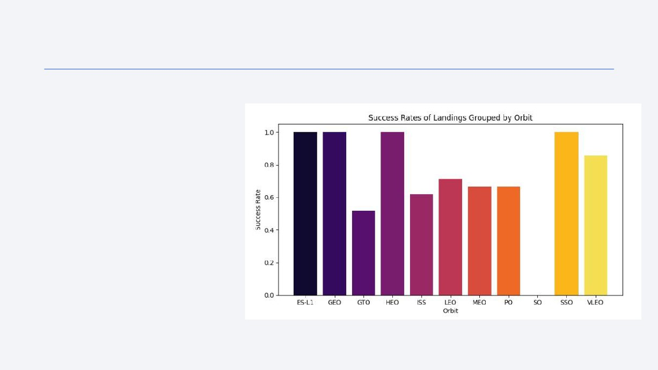
Success Rate vs. Orbit Type
• ES-L1, GEO, HEO, and SSO are
the most successful orbits
• VLEO is still very successful
• Launches to GTO, the ISS, or SO have proven very risky for
landing (60% success rate or
lower)
21

Slide 22
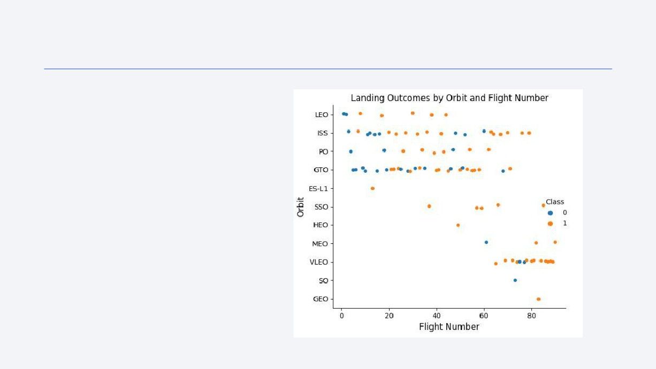
Flight Number vs. Orbit Type
• Launches to orbits including the ISS,
PO, and GTO can be confidently deemed 'risky landing' because of
the larger amount of attempts
• LEO, SSO and VLEO can confidently
be deemed 'likely to succeed' due to the large number of successes
• ES-L1, HEO, MEO, SO, and GEO
have minimal launch/land attempts. Their success rates may not be as accurate as other orbits
22

Slide 23
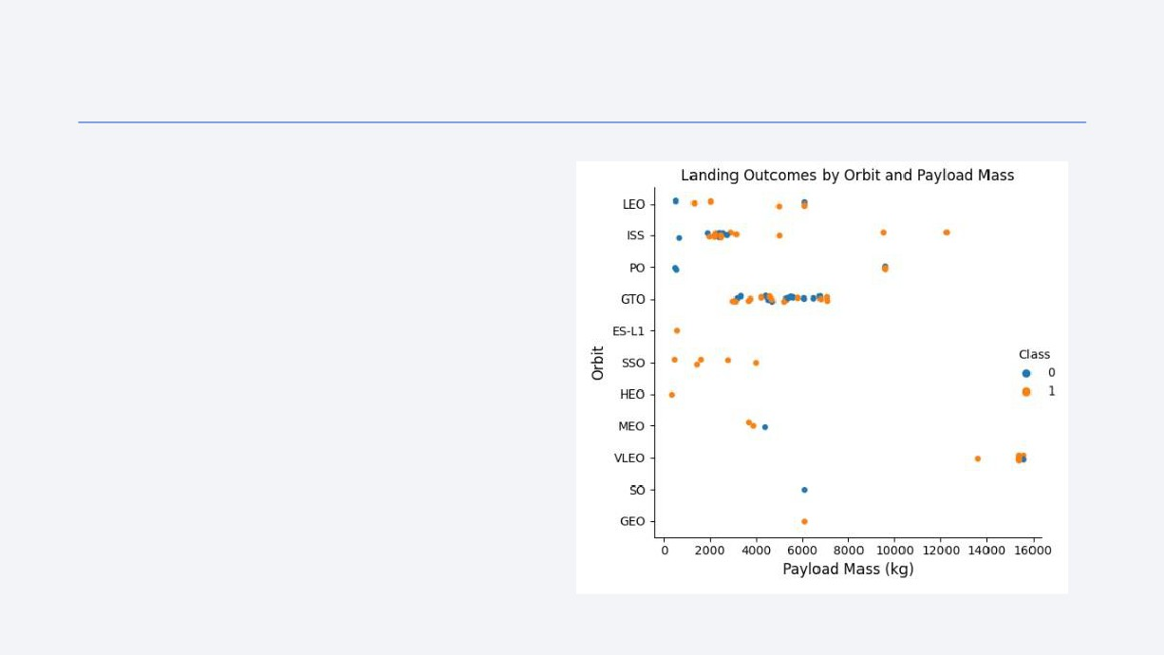
Payload Mass vs. Orbit Type
• This chart is telling of approximately how far each orbit is from Earth's surface. For instance, VLEO (very low Earth orbit) is only about 450km out, so it's easier to move more massive payloads the shorter distance
• Meanwhile, GEO is about 36,000km out, so a lighter payload is used
• If there is a very massive payload going to be
shipped very far out (or a payload mass outside of SpaceX's usual mass for that orbit), the chance of failure may increase
23

Slide 24
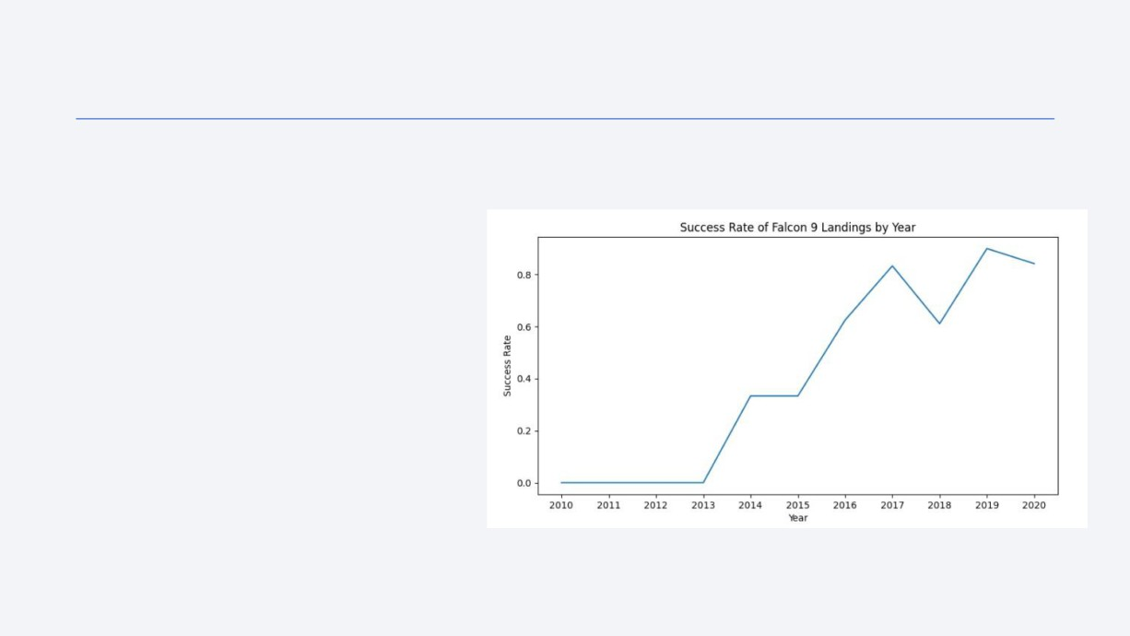
Landing Success Yearly Trend
• From 2010 to 2020, the
success rate of rocket launches/landings has (basically) only gone up
• There was a small dip in
success in 2018, but this
does not detract from the overall success rate since there is still a net positive between 2017 and 2019
24

Slide 25
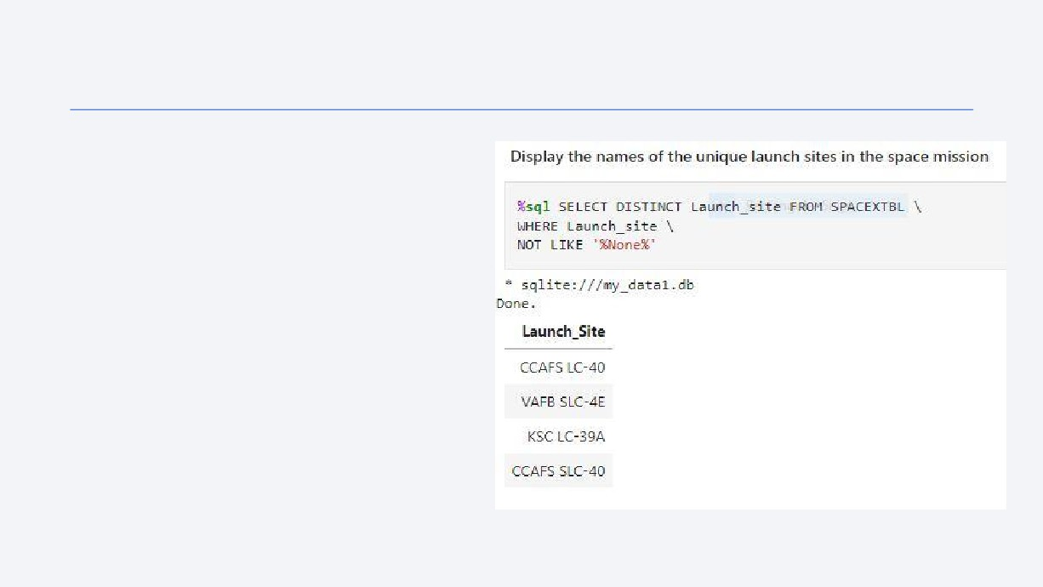
All Launch Site Names
• The query returned all unique launch site names
• The NOT LIKE '%None%' was added
in order to eliminate a 'None' that
would appear when querying for the
launch sites
25

Slide 26
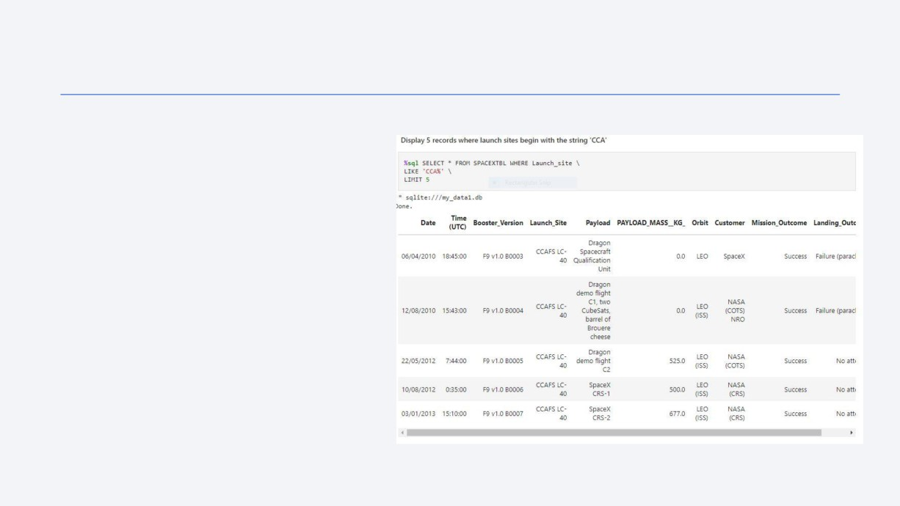
Launch Site Names Begin with 'CCA'
• The query returns the first 5
records containing a launch site that begins with CCA
• This includes the launch sites CCAFS LC-40 as well as CCAFS SLC-40 (not pictured in the first 5 entries)
26

Slide 27
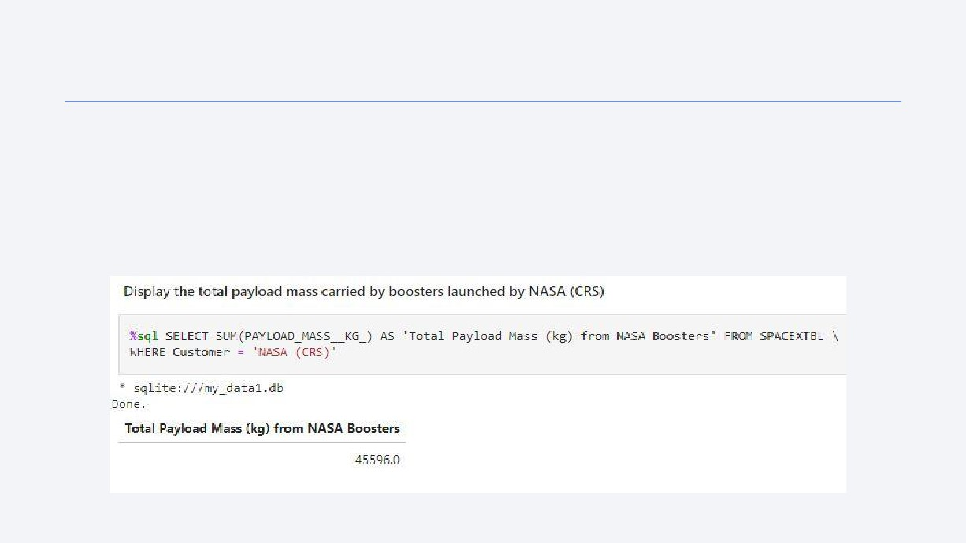
Total Payload Mass
• The query adds all payload masses carried by boosters launched by NASA
• The customer was limited to only NASA and a sum of all values was used to obtain this result
27

Slide 28
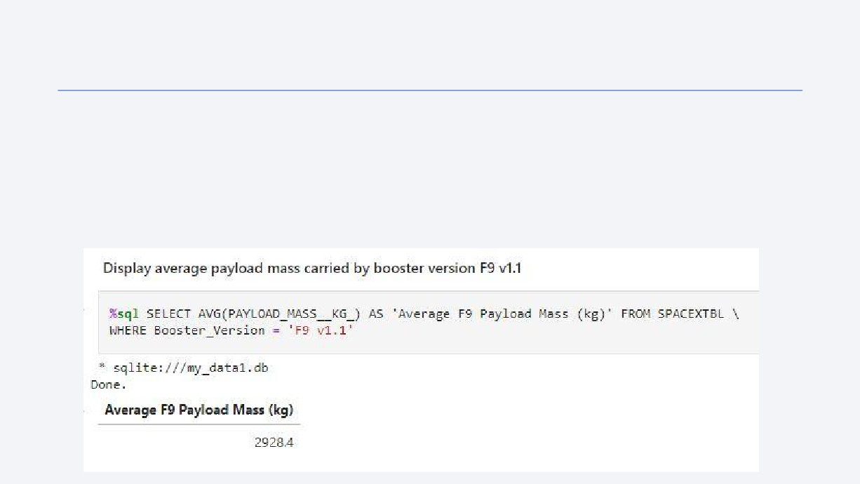
Average Payload Mass by F9 v1.1
• The query returns to average payload mass carried by the F9 v1.1 booster
• This was obtained by limiting the booster version to F9 v1.1 and averaging those payload mass values
• This data will be pertinent should the F9 v1.1 booster be used for more massive payloads in the future, since the average 2928.4kg is relatively light
28

Slide 29
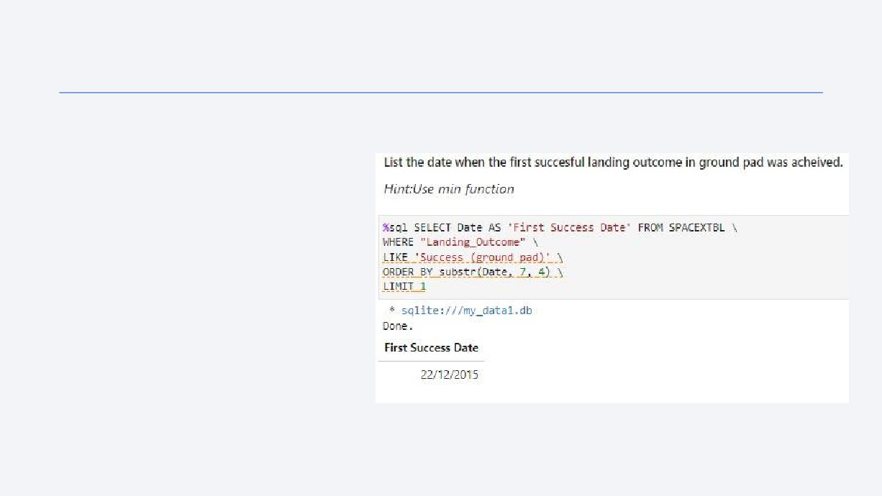
First Successful Ground Landing Date
• The query was used to find the first
date during which a ground landing was successful
• Due to the dates not being in a
'year-first' format, the dates were all queried then ordered by year manually. The first listed date 'December 22, 2015', is the first successful ground pad landing date
29

Slide 30
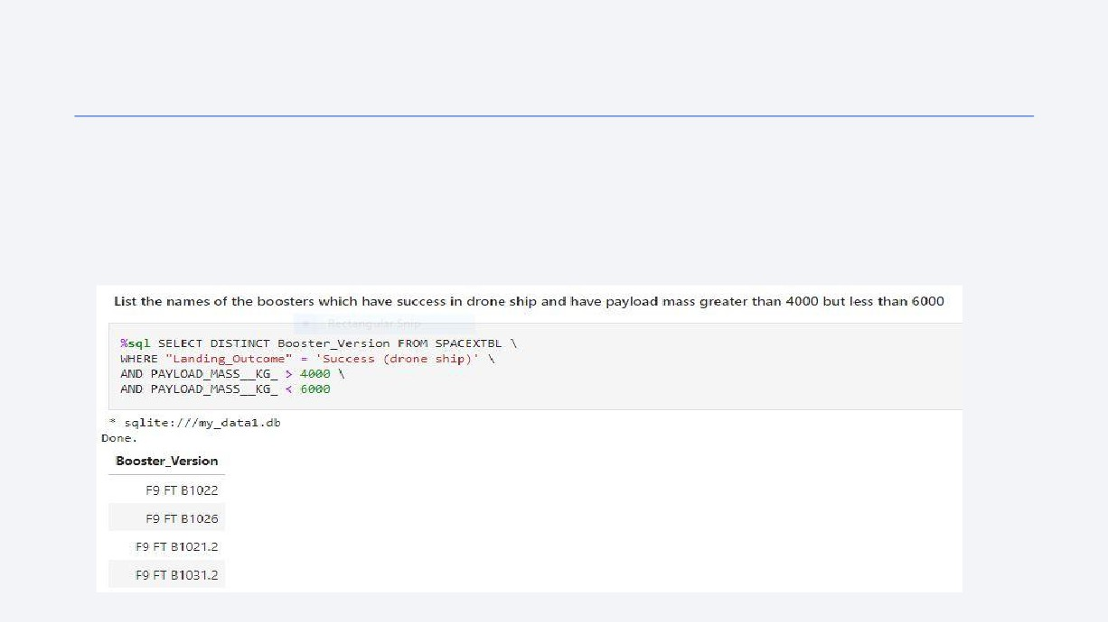
Successful Drone Ship Landing with Payload between 4000kg and 6000kg
• The query gathered the booster versions that were able to land safely via drone ship while carrying a payload mass between 4000kg and 6000kg by limiting the date to Successful drone ship landings and payload masses to 4000kg-6000kg
• This information can be a useful predictor of success should SpaceX decide to launch another payload between 4000kg and 6000kg
30

Slide 31
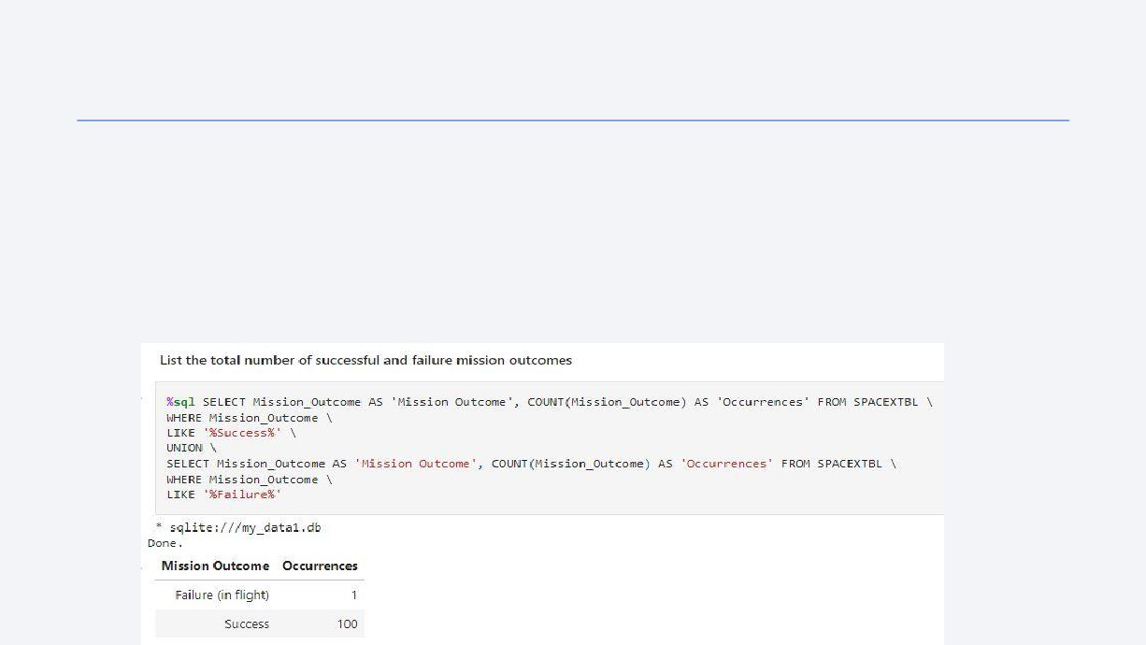
Total Number of Successful and Failure Mission Outcomes
• The query is two separate queries
• The first query totals all successful mission outcomes
• The second query outputs all failed mission outcomes
• The 'UNION' line combines both queries into one data frame
• SpaceX has over a 99% mission success rate if the rocket gets off the ground
31

Slide 32
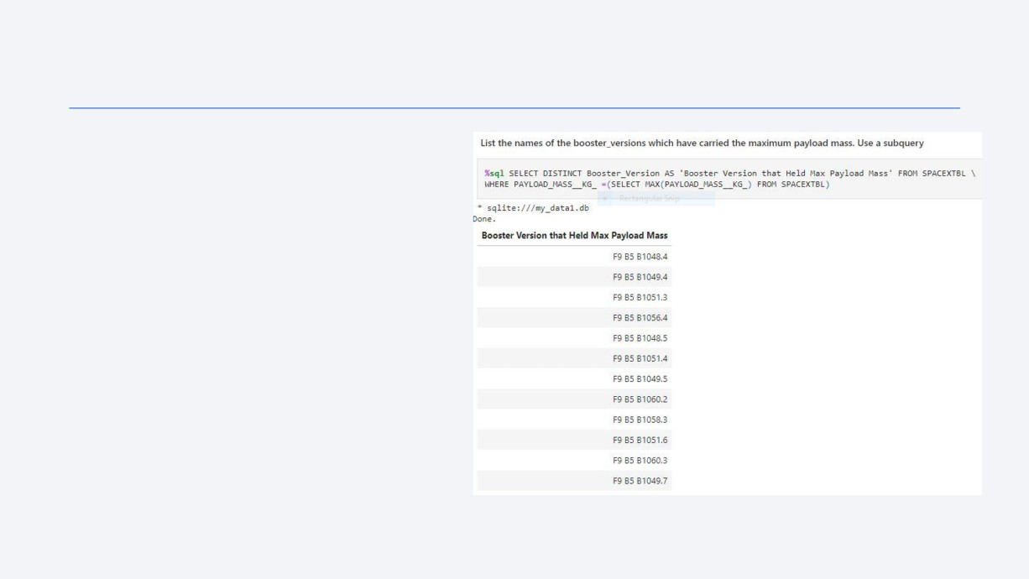
Boosters Carried Maximum Payload
• The query outputs all booster
versions that have carried the max
payload weight by filtering the data by maximum payload weight then listing all distinct booster versions
• This data will be useful should
SpaceX decide to launch very
massive payloads in the future
32

Slide 33
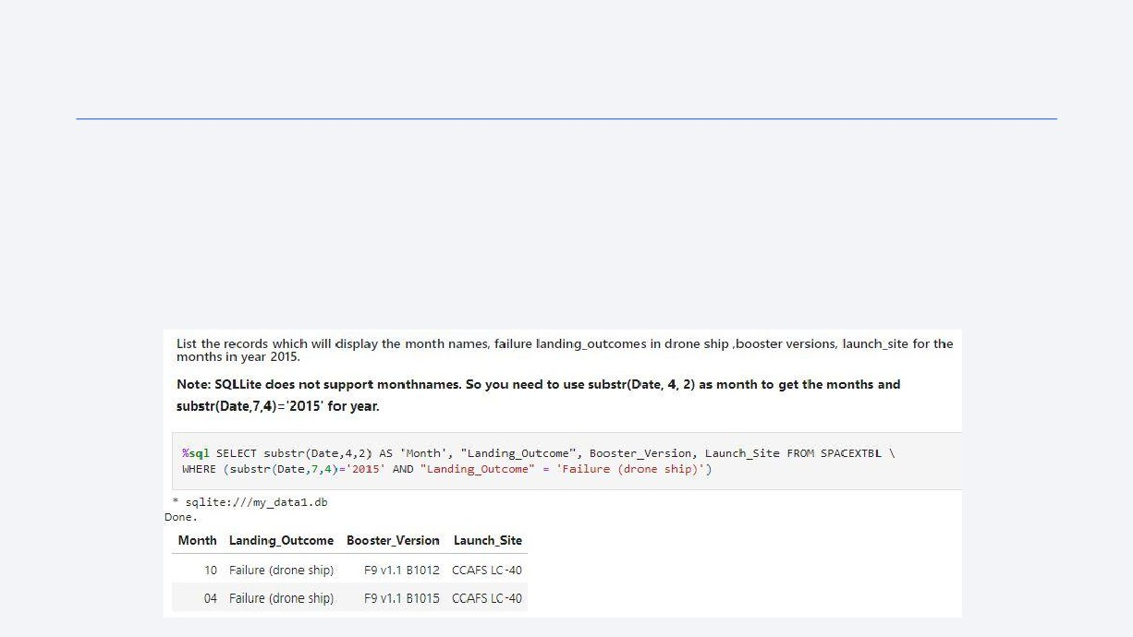
2015 Launch Records
• The query outputs records for failed drone ship landings that occurred during 2015.
The months are listed instead of the date
• It should be noted that both failures occurred while at the CCAFS LC-40 launch site,
which may be pertinent info in the future
33

Slide 34
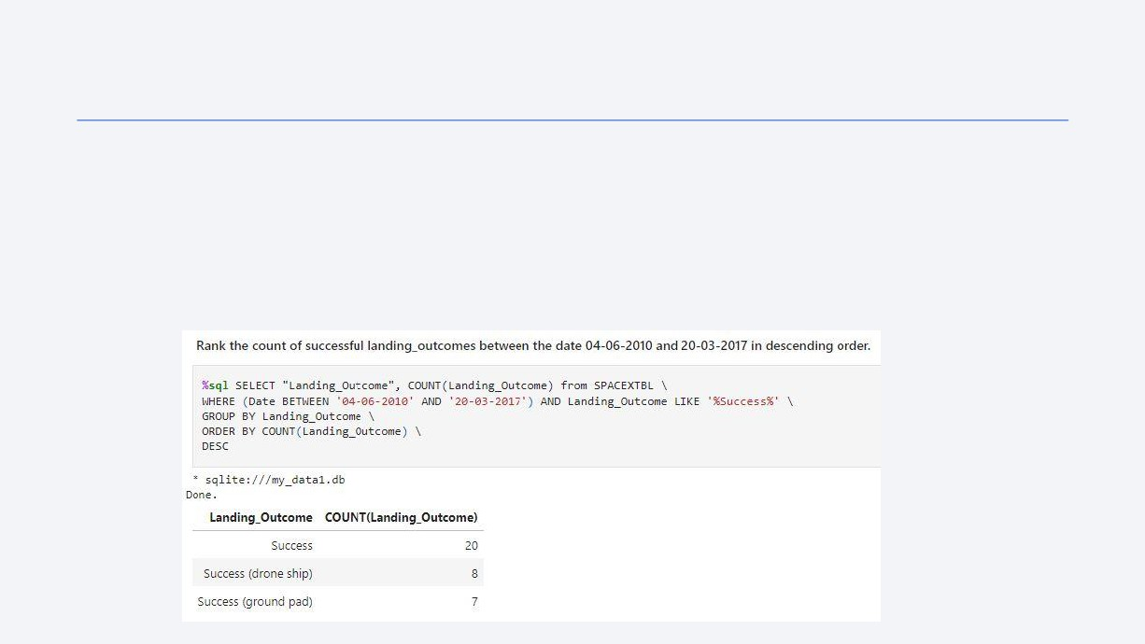
Rank Landing Outcomes Between 2010-06-04 and 2017-03-20
• The query outputs the number and type of successful landings between the dates of 06/04/2010 and 03/20/2017 and ranks them by total value by ordering by count of each distinct type of landing outcome
• Between the aforementioned dates, there was not much difference between drone ship and ground pad landings.
34

Slide 35

Section 3

Slide 36
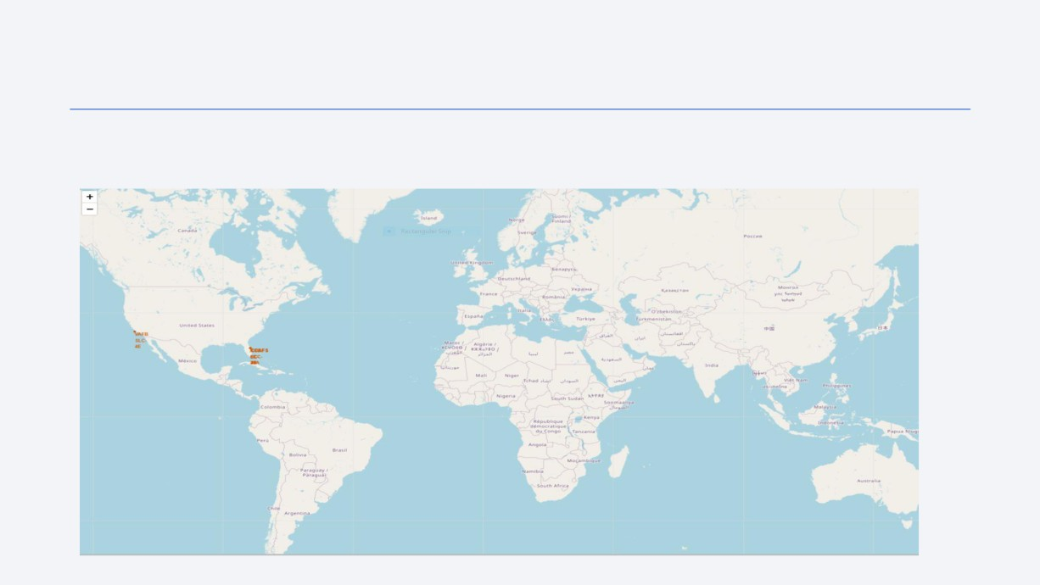
SpaceX Launch Sites on the Global Map
• SpaceX's launch sites can be seen on this global map as orange dots. There are 3
sites in Florida (USA) and one site in California (USA). All launch sites are on coastlines
36

Slide 37
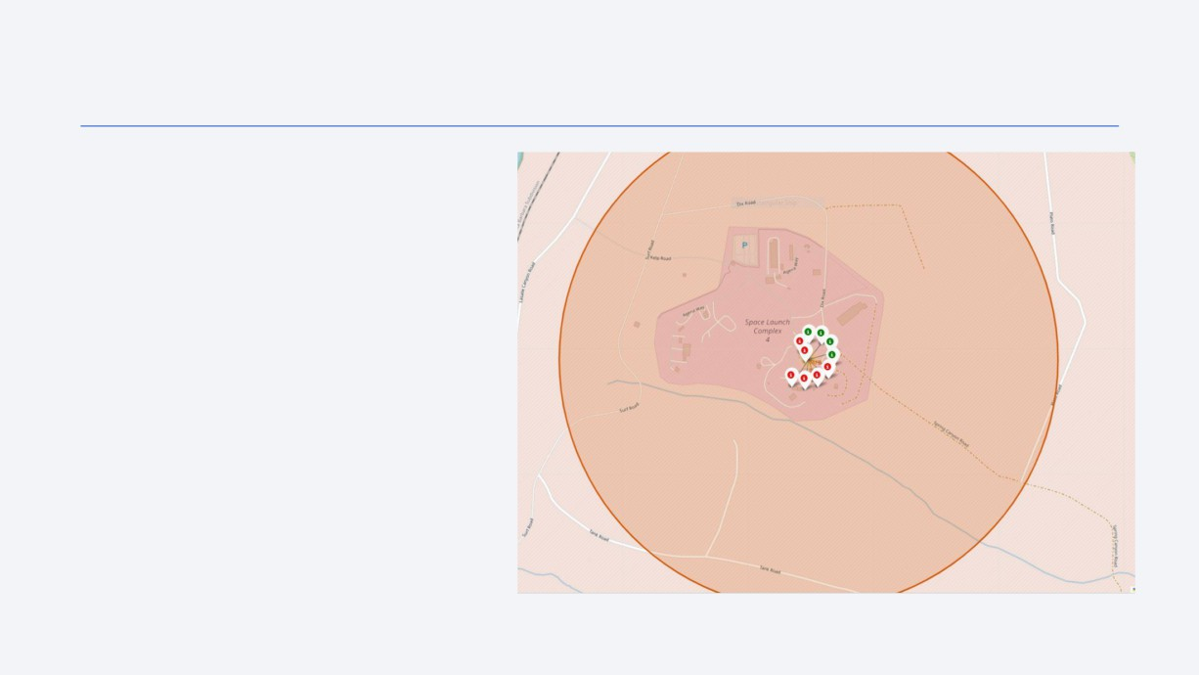
Launch Site Map and Success
• The California-based VAFB SLC-4E
is pictured with markers denoting the SpaceX successes (green markers) and failures (red markers) that took place
• The markers begin collapsed onto one marker that can be clicked on and exploded into the various markers shown
37

Slide 38
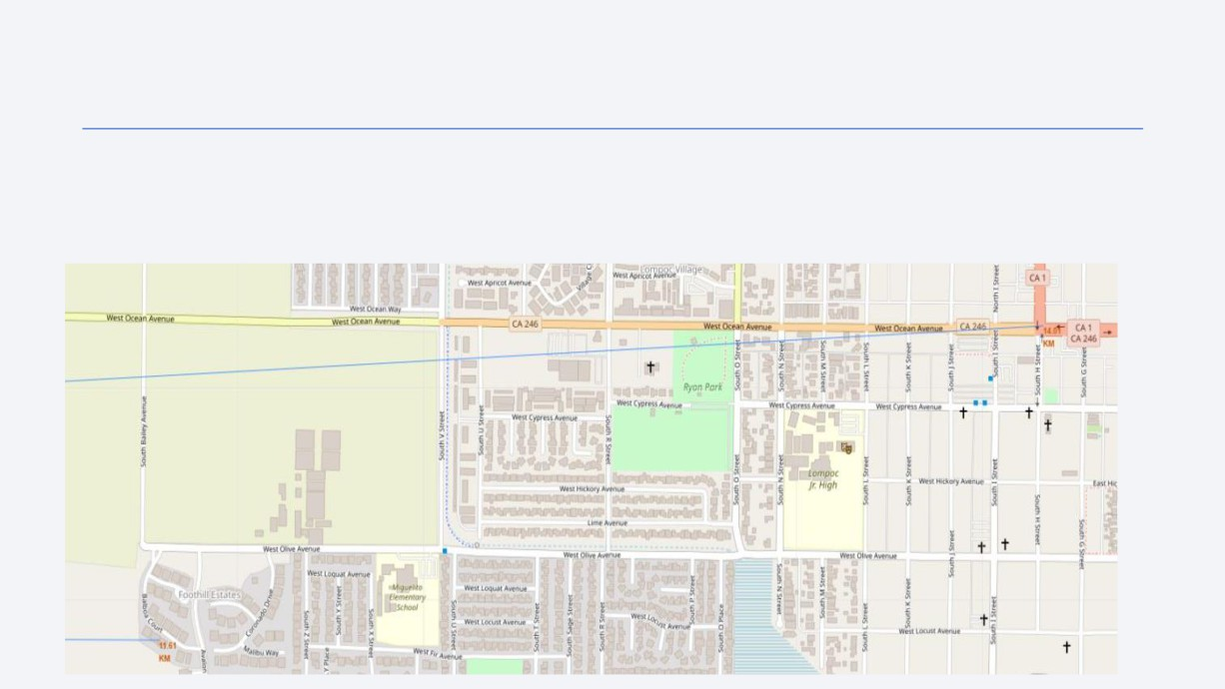
Launch Site Distance to Civilization
• From the launch site, the closest city limit, Lompoc, CA (marked at the bottom left), is 11.61km away
• The closest highway, the convergence of CA-1 and CA-246 (marked at the top right) is 14.01km away
• Civilization is far sufficiently far away from launch sites should a launch go wrong
38

Slide 39
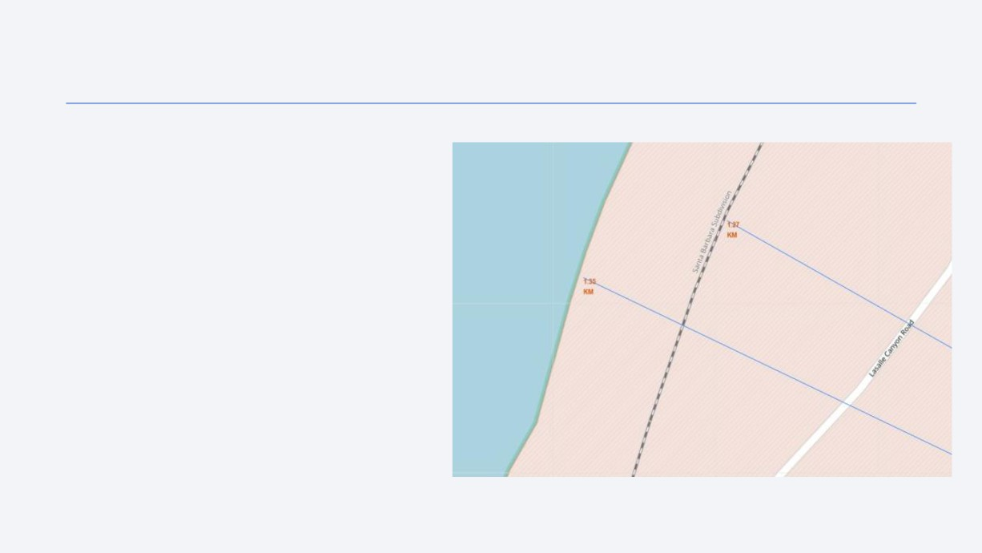
Launch Site Distance to Coast and Rail
• The launch site is 1.35km from the
coastline of the Pacific Ocean. The site is
1.27km from the Santa Barbara
Subdivision of the Southern Pacific rail line
• The site is close to water. Should a launch go wrong, the rocket can potentially be steered towards the ocean
• The site is close to a railroad.
Although civilians do ride this line and
launch sites aren't typically near civilian
transit, being close to a railroad in order to
have heavy rocket parts transported is
beneficial
39

Slide 40

Section 4

Slide 41
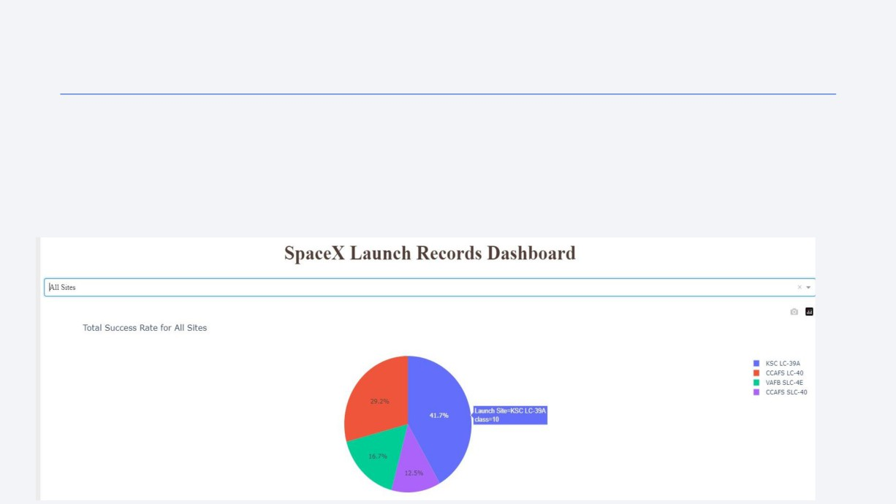
Comparing Launch Site Success
• The dashboard displays that the KSC LC-39A makes up 41.7% of all launch site success
• The next most successful site is the CCAFS LC-40 with 29.2%
• This will be important for determining success when SpaceX denotes which launch site will
be used for a future mission
41

Slide 42
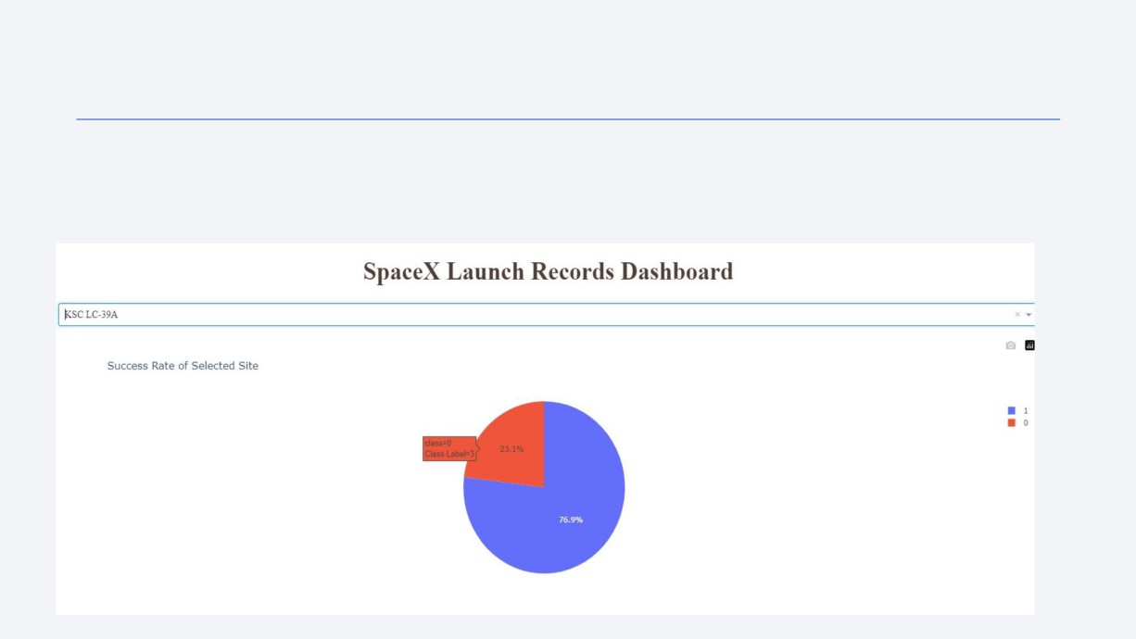
Success Rate at KSC LC-39A
• The launch site with the highest success rate is the KSC LC-39A with a 76.9% success rate.
• This could easily be determined visualize thanks to the Plotly pie chart and dropdown
selection bar
42

Slide 43
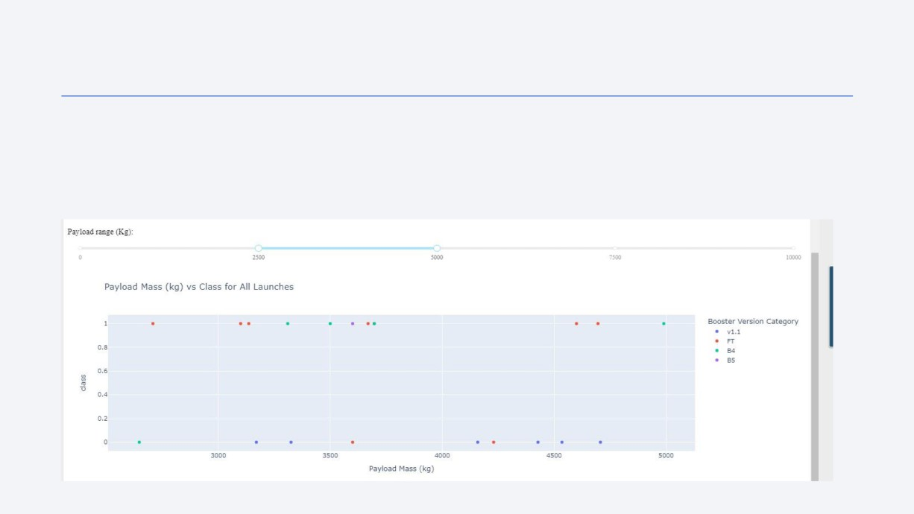
Scatter Plot of Success Rate for Varying Payloads
• Using the payload slider, it can be seen that there is a varying level of success for payload masses between 2500kg and 5000kg.
• The FT booster version performs the best at this weight range while the B5 performs the worst
43

Slide 44
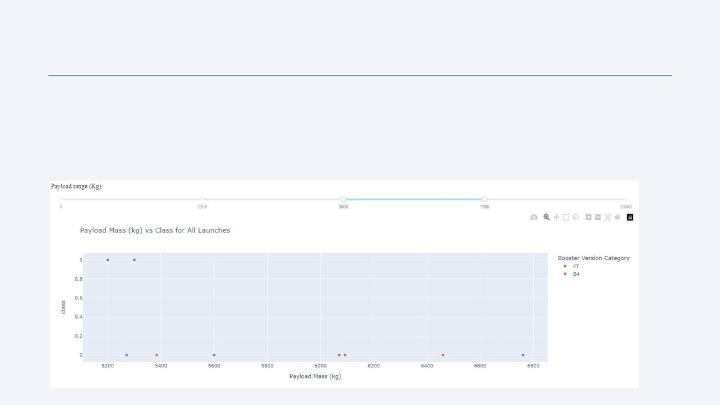
Scatter Plot of Success Rate for Varying Payloads
• Adjusting the payload slider to a payload mass between 5000kg and 7500kg shows an overwhelmingly high failure rate when compared to lighter payload masses
• The FT booster is pretty unreliable at this weight range. The B4 had yet to be successful at the given weight range
44

Slide 45

Section 5

Slide 46
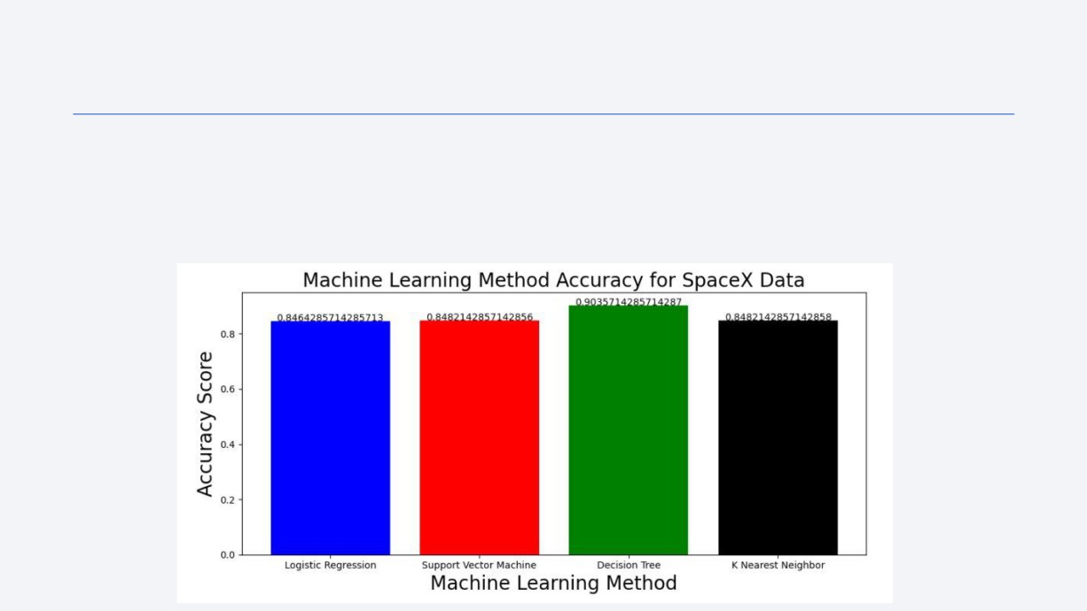
Classification Accuracy
• The model with the highest accuracy is the decision tree method with over a 90%
potential accuracy
• Despite the other methods hovering around 84% maximum accuracy, the decision tree is still significantly more accurate
46

Slide 47
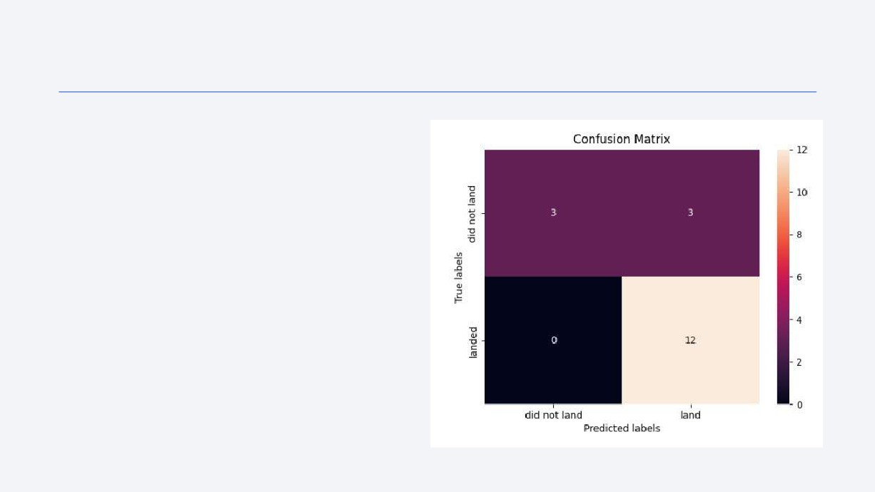
Confusion Matrix of Decision Tree Method
• The confusion matrix for the decision
tree method shows that it did not create any Type 2 error (false negative), denoted by the black '0' box on the bottom left
• All error was Type 1 error (false positive), denoted by the purple '3' box at the top right (predicted to land but did not land)
• The model was mostly accurate, denoted by the top left and bottom right boxes
4

Slide 48
Conclusions
• The highest payload mass success rate was at heaviest weights (10,000kg+), but most flights
have lower mass payloads (7000kg or less)
• The orbits with highest success rates were closer to Earth, such as LEO, VLEO, and SSO. Farther orbits, such as GTO and ISS, were much less successful. Covering more distance means there is more of a chance something breaks or malfunctions during travel
• The KSC LC-39A site has seen the most launch/land success out of all SpaceX sites
• The yearly success rate trend line for SpaceX rockets launches/landings has a positive slope, predicting an even higher success rate in years to come
• SQL queries and the dashboard have helped determine which combinations of boosters, payload weights, and launch sites have seen mission/landing success and which have seen failure. These methods will be useful for predicting outcomes of future flights using not-yet seen combinations of boosters and payloads
• The decision tree model was the most accurate machine learning algorithm for the SpaceX data when properly tuned. Though, SpaceY should be weary of Type 1 error in the future
48

Slide 49
Appendix
• Full Github Repository link :
https://github.com/SriChandra2520/IBM-Applied-Data-Science-Capstone-Final-Presentation/tree/main
49

Slide 50
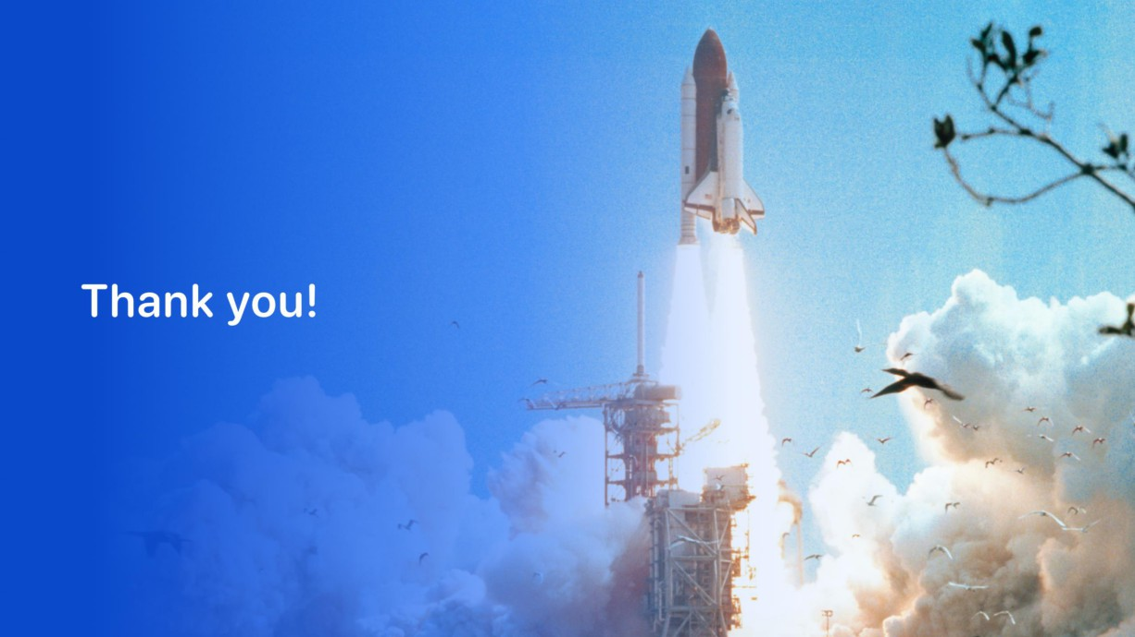
Shoot for the stars!

